Slide 1
Welcome to 6th Grade Accelerated Mathematics

Slide 2
What are we covering this year?
Rational Numbers (6th & 7th)
Number Fluency (Current) (6th & 7th)
Expressions (6th & 7th)
Equations & Inequalities (6th and 7th)
Rates & Ratios
Area & Volume
Statistics

Slide 3
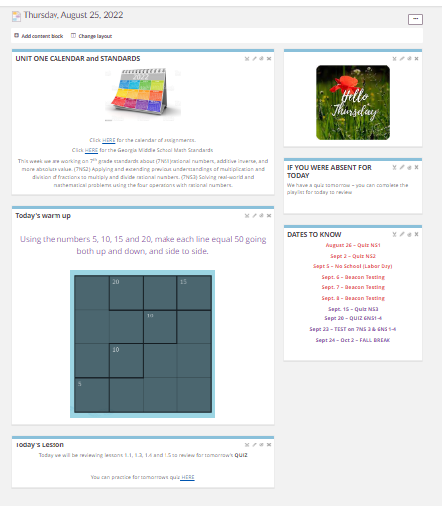
Please make sure to have your student pull up the daily page on ItsLearning if they are absent. You can also see upcoming important dates, a calendar, and the standards we are covering.

Slide 4
Classroom Resources
Envisionmath/Savvas Math 2.0
Student workbooks
Online access - Classlink - Math folder/Savvas
Delta math (online via classlink)

Slide 5
How is my student graded?
SUMMATIVE – 80%
Summative grades include assessments, such as tests and projects, given after a unit of study has been completed. These grades represent the student’s level of mastery of the Georgia Standards of Excellence.
FORMATIVE – 20%
Formative grades include quizzes and tasks that provide students with practice while learning standards in a given unit. These assignments are used to inform both the teacher and the student of the student’s developing level of mastery of the Georgia Standards of Excellence.

Slide 6
Mastery Learning Plan/Recovery
1 test re-take per semester for advanced/accelerated)
All formative work must be completed prior to re-assessment
Reassessment opportunities are given during FLEX time, or by appointment as necessary.
Student will receive full credit for the reassessment.
In the event of a lower score, the higher of the two assessment grades will be recorded.

Slide 7
HELP!!!!
If a student feels the need for extra help, they can:
Come to my “FLEX TIME” Help Session on FRIDAYS.
I’m also available most mornings with an appointment (that sounds so formal - just send me an e-mail!)
Parents - one parent to another - bookmark Kahn Academy! It will help you all the way to college math!

Slide 8
BYOT Policy
Unless a teacher indicates that it is appropriate for students to use technology specifically for a BYOT lesson or activity, there should be ​NO technology use from 9:00 am - 4:15 pm​.
If a student is using technology without a teacher’s permission, his/her technology will be taken.
We have cell phone racks available for them in the back of room...

Slide 9
ATTENDANCE & Make-up Work
Attendance is important, but if student misses school they should, if possible follow along on ITS Learning & complete ALL work. I turn on the page first thing in the morning, and it will be ready to go.
All work can be found on ITS Learning (posted NLT 5pm same day)
Bring all completed work to class on day of return
If child misses a Quiz or Test they should talk with their teacher to make a plan to get it taken care of.

Slide 10
HELPFUL HINTS!
Sign in as your student “see what they see”!
Download the Infinite Campus app
Toggle “notifications” on
Answer Keys !
Students should contacting using ITS Learning (Parents through email)

Slide 11
Curriculum Night
QUESTIONS ?

Slide 12
Procedures if Technology is being used inappropriately during school hours
Offense # | Consequence
1 | -Student will receive a discipline slip. -Reporting teacher will keep technology until the end of the school day.
2 | -Student will receive a discipline slip. -Reporting teacher will send technology to the front office for a parent to pick up. -Student should not use technology for one week. -Student will serve a silent lunch
3 | -Student will receive a discipline slip. -Reporting teacher will send technology to the front office for a parent to pick up. -Student should not use technology for two weeks. -Student will serve a silent lunch
4 | -Student will receive an office referral.

Slide 13
What is Friday Academy?
Friday Academy meets twice a month to provide an opportunity for students to catch up on work that is past due for their classes. Students will stay at school with the assigned teachers and admin from 4:15-6:15 p.m. to make sure they are successfully completing their work. This will start in October and will continue periodically through the end of the year. Will call or email to confirm… “No news is good news”.

Slide 14
Friday Academy Policies and Rules
How does a student get recommended for Friday Academy?
If a student is missing ANY work they are recommended for Friday Academy.
How will I know if my student is in Friday Academy?
Parents will be called and emailed by the teacher the Monday BEFORE Friday academy.
What are the hours of Friday Academy?
Friday Academy will be held from 4:15-6:15 p.m. All students should be picked up no later than 6:15 p.m. Students will text parents at 4:15 reminding them of the pick up time. Students will not have access to their phones after this time and until 6:15 p.m.
What if my student finishes their assignment before Friday Academy?
If a student finishes his/her assignments by 4:15p.m. the Thursday before Friday Academy, they will be taken off the Friday Academy list. Any work completed after that will be turned in during Friday Academy. We advise that students bring a book to read in case they finish early. Student who are attending Friday Academy are required to stay the entire 2 hours, whether or not they finish early.
Our next Friday Academy for the 2020-21 school year will be Friday, Oct 9th

